Slide 1
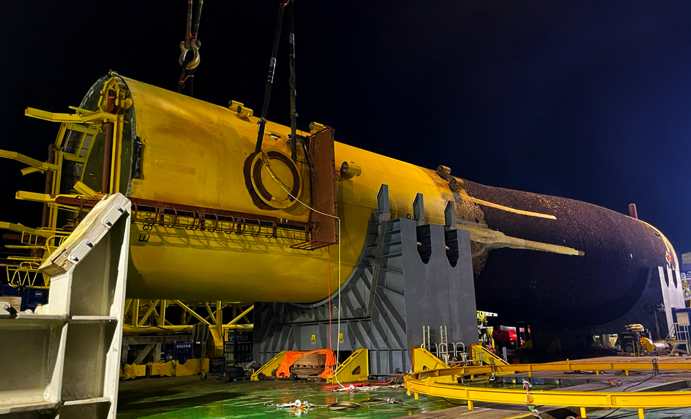
World-first 10m diameter wind turbine monopile severance
James Fisher completed the world’s first abrasive cut on a 10m-diameter offshore wind turbine monopile, on behalf of an international energy operator.
Offshore windfarm
2025
10 m
An offshore wind operator identified a flaw in the foundation of a 10m diameter monopile after installation. With no proven method to safely sever this large structure, they faced a significant challenge in safely removing it while minimising downtime and reducing environmental impact.
By applying our decommissioning expertise and innovation within offshore wind, we’ve shown that large-scale decommissioning can be done safely, efficiently and with the environment front of mind.
MARK STEPHEN, PRODUCT LINE DIRECTOR, (DECOMMISSIONING),
JAMES FISHER & SONS PLC
Safe and rapid removal of the flawed monopile, enabling recovery to the vessel deck without incident
Reduced environmental impact thanks to shorter operational timeframe
Cost efficiency through a purpose-built tool which avoided the need for multiple interventions
This approach combined the efficiency and reliability developed through decades of oil and gas projects with innovation tailored to offshore wind’s unique demands
diameter monopile cut
1
James Fisher designed, built, tested and deployed a bespoke external abrasive cutting tool – the first of its kind capable of tackling monopiles of this scale. The tool was deployed subsea to complete an abrasive waterjet cut in one pass.
One pass, one cut

